Slide 1


Society Management System
Submitted by :
Kunal (233165)
Siddhant Malik (233215)
Guided by :
Mrs. Monika
Mr. Harshal Waghchaure

Slide 2
INTRODUCTION
Society Management System is a web based application which can manage the different functionalities of a society online. Such as :
Visitor details
House owner details
News and events
Facilities of the society

Slide 3
OBJECTIVE
The objective of Society Management System is to make the basic functionalities of a society online.
These functionalities are :
Security guard : Registering visitor details
House owner : Viewing News and Events in the society
House owner : Booking Facilities in the Society
Admin : Adding and modifying the User list
Admin : Updating Facilities and Bookings
Admin : Updating News and Events

Slide 4
SCOPE
Future scope of application are :
Send sms alerts to House owners using Twilio API for :
Visitor details as soon as Security guard register a visitor’s details.
Booking confirmation and details of a facility

Slide 5
TECHNOLOGIES USED
Spring Boot
Java
JavaScript and JSX
ReactJS
MySQL

Slide 6
SOFTWARE & HARDWARE CONFIGURATION
Client-Side Requirements (React):
Hardware:
Modern computer with at least 4GB RAM.
High-resolution display for better user experience
Software:
Web browser (Google Chrome, Mozilla Firefox, Safari, etc.).
Text editor or integrated development environment (IDE) for coding (Visual Studio Code, WebStorm, etc.).

Slide 7
Server-Side Requirements (Java + MySQL):
Hardware:
A server or hosting environment with sufficient resources based on the expected traffic and usage. The exact specifications depend on the anticipated load.
Software:
Java Development Kit (JDK): Required to develop and run Java applications.
MySQL Database: Required for storing application data.
Web Server (optional): Apache Tomcat, Jetty, or similar if using Java for server-side logic.

Slide 8
FUNCTIONALITIES
Security guard :
Record Visitor details
Update Visitor details
View News and Events
House owner:
View News and Events
Book Facilities
View Booking history
Edit Bookings

Slide 9
Admin :
Adding/Modifying User details
Adding/Modifying Visitor details
Adding/Modifying News and Events
Adding/Modifying Facilities
Adding/Modifying Bookings

Slide 10
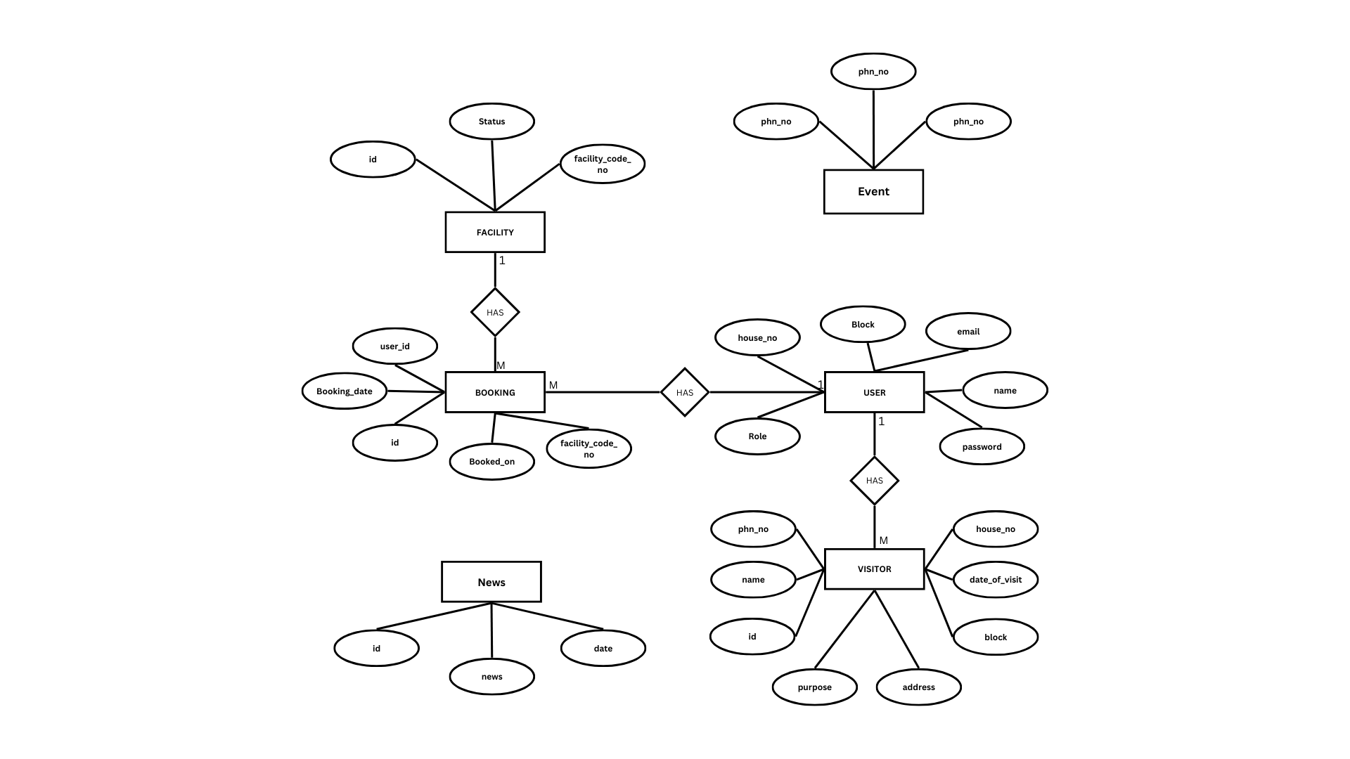
ER DIAGRAM

Slide 11
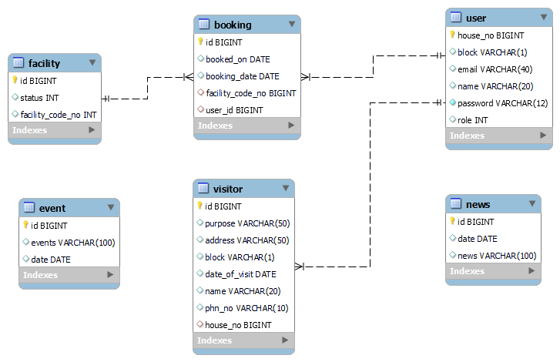
CLASS Diagram :

Slide 12
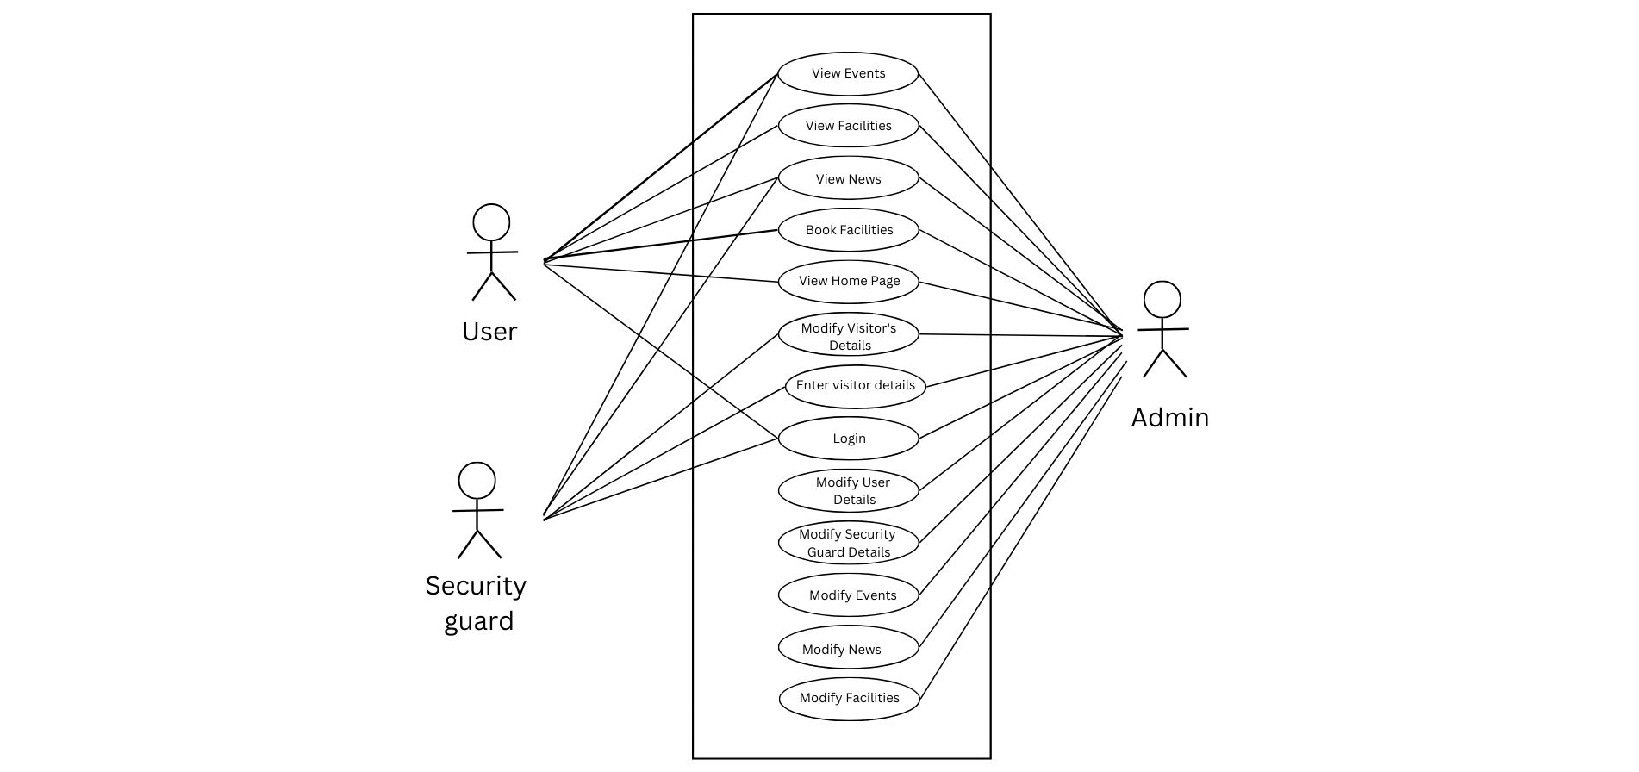
Use Case Diagram :

Slide 13
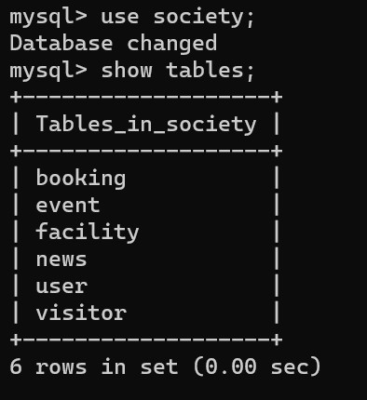
DATABASE DESIGN
Tables :

Slide 14
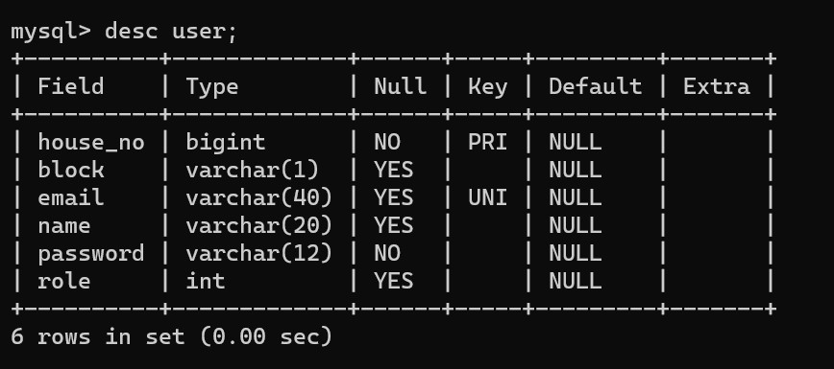
Users :

Slide 15
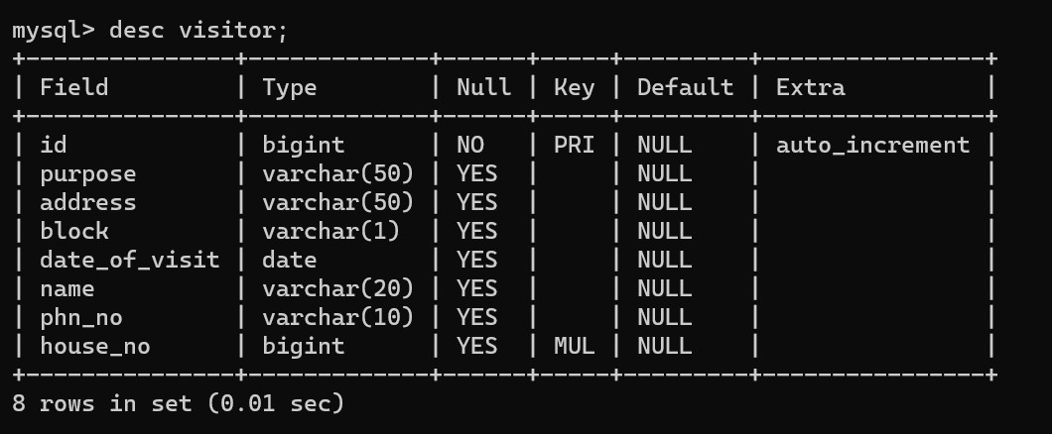
Visitors :

Slide 16
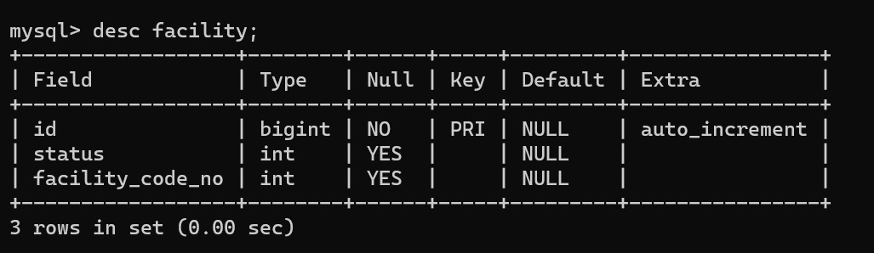
Facilities :

Slide 17
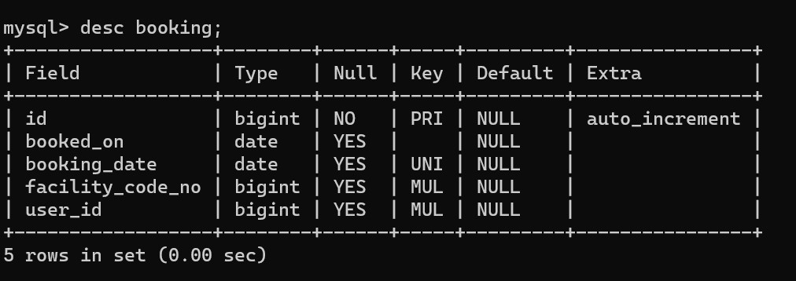
Booking :

Slide 18
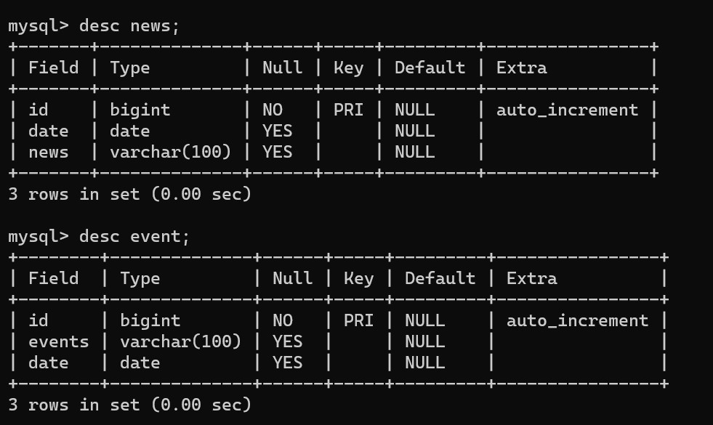
News and Events :

Slide 19
SCREENSHOTS

Slide 20
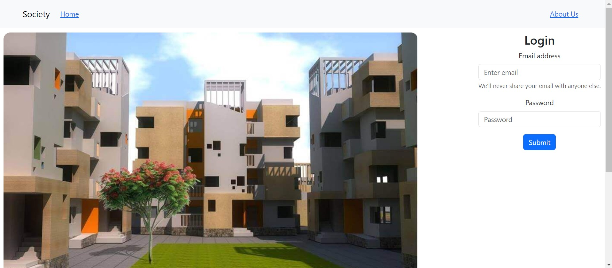
Home Page :

Slide 21
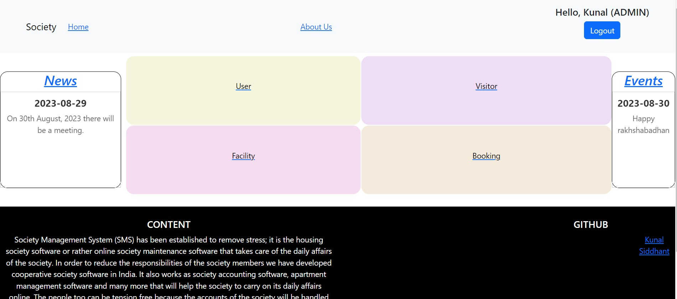
Admin:
Admin Home page :

Slide 22
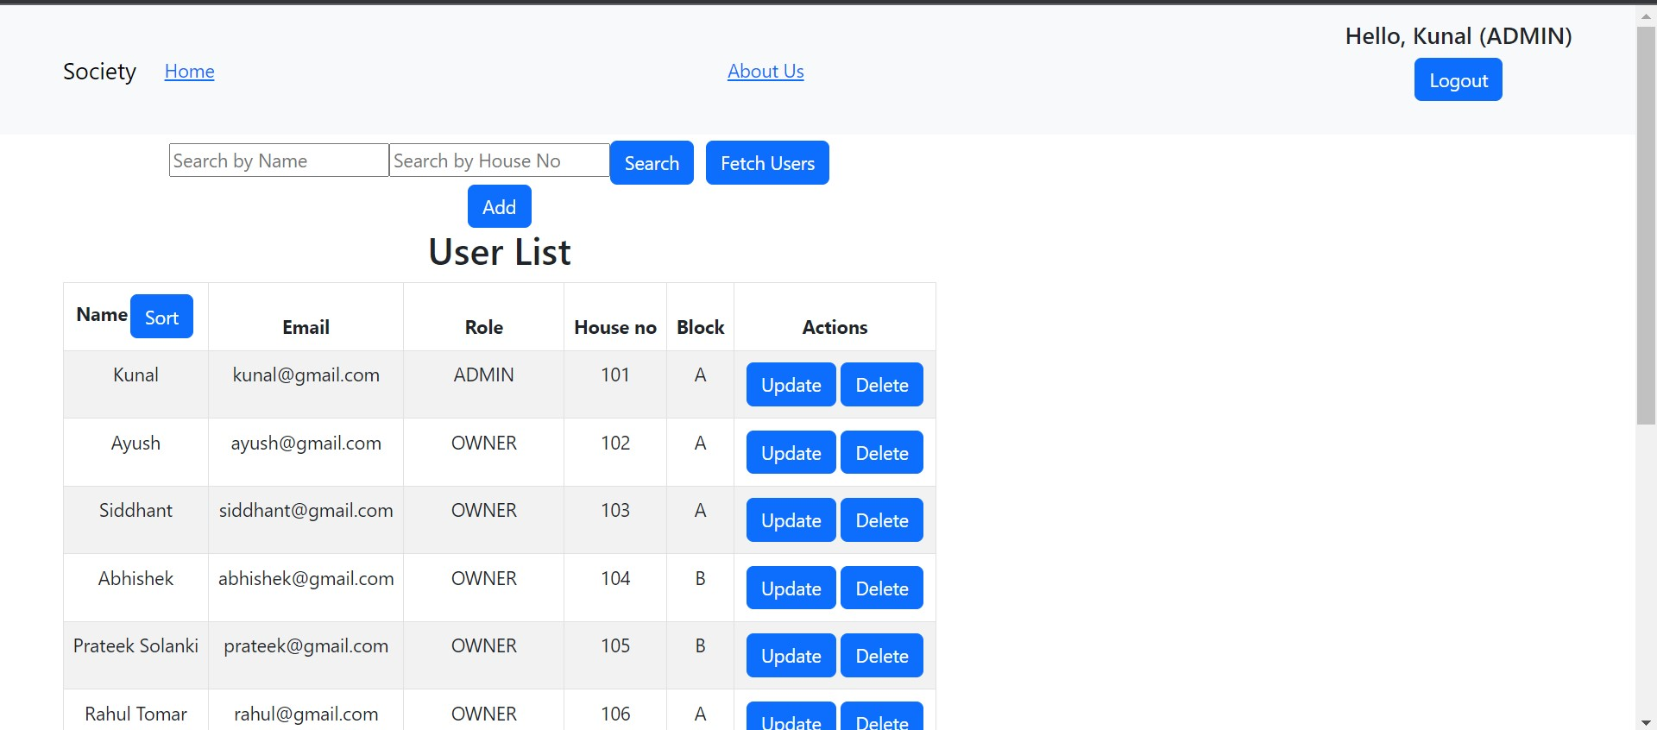
User page in Admin:

Slide 23
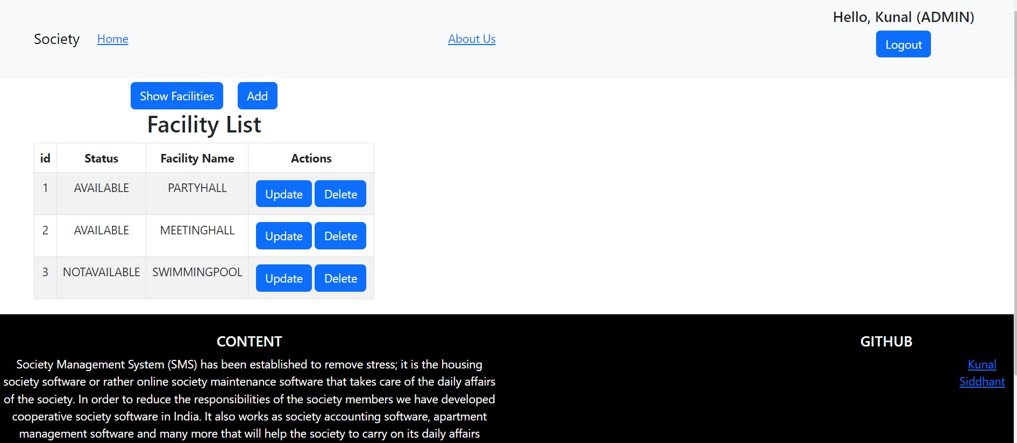
Facility page in Admin :

Slide 24
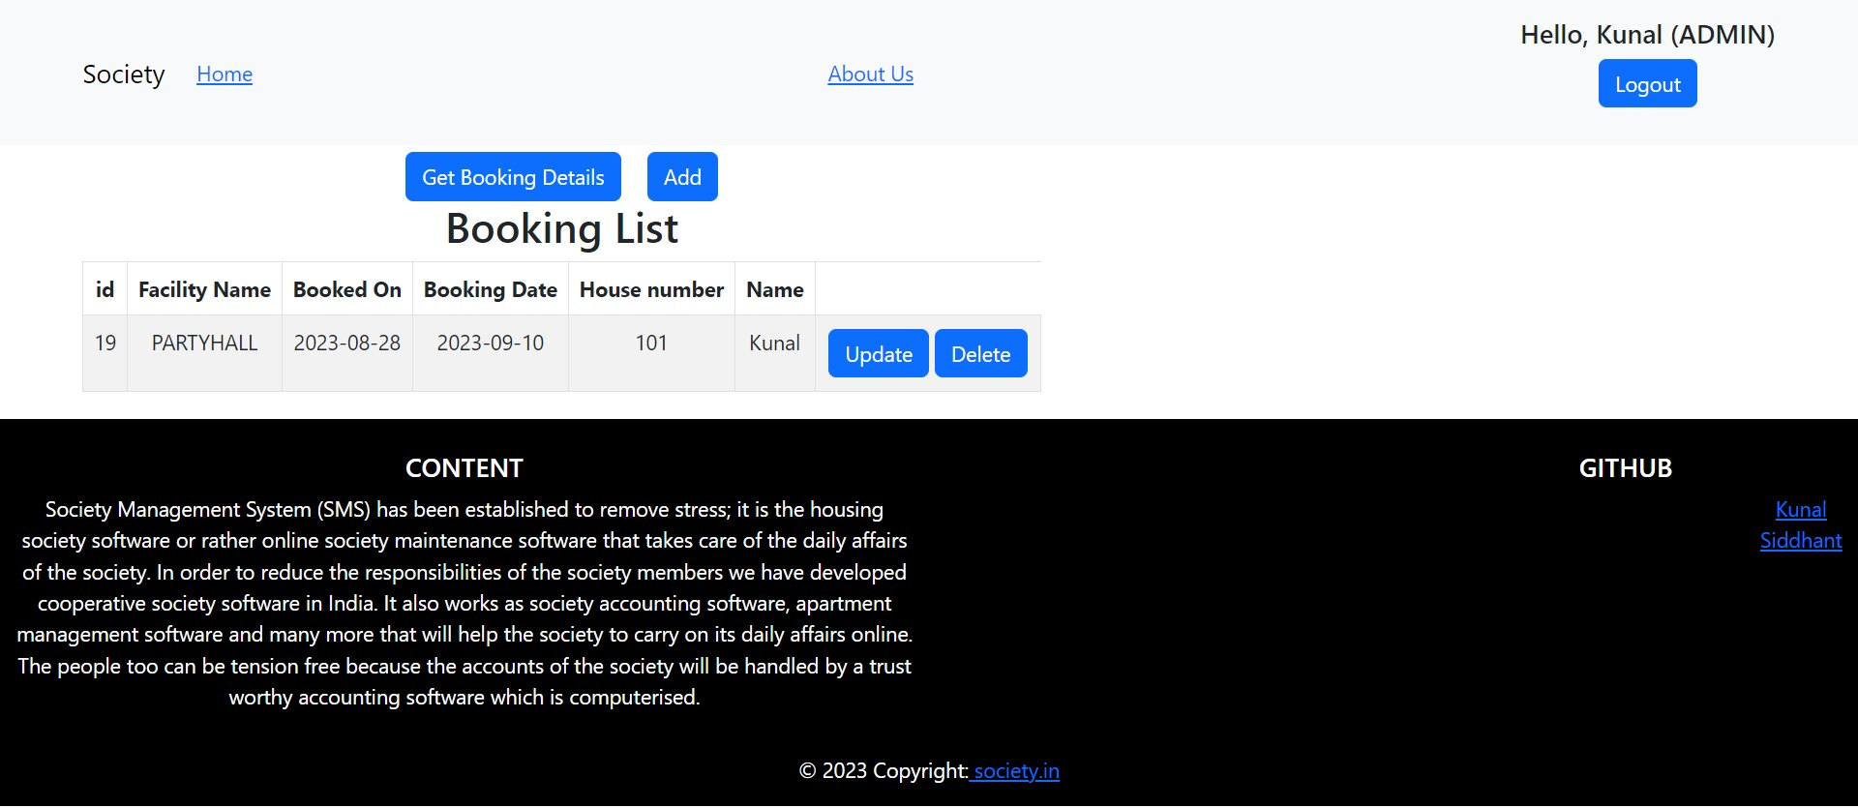
Booking page in Admin :

Slide 25
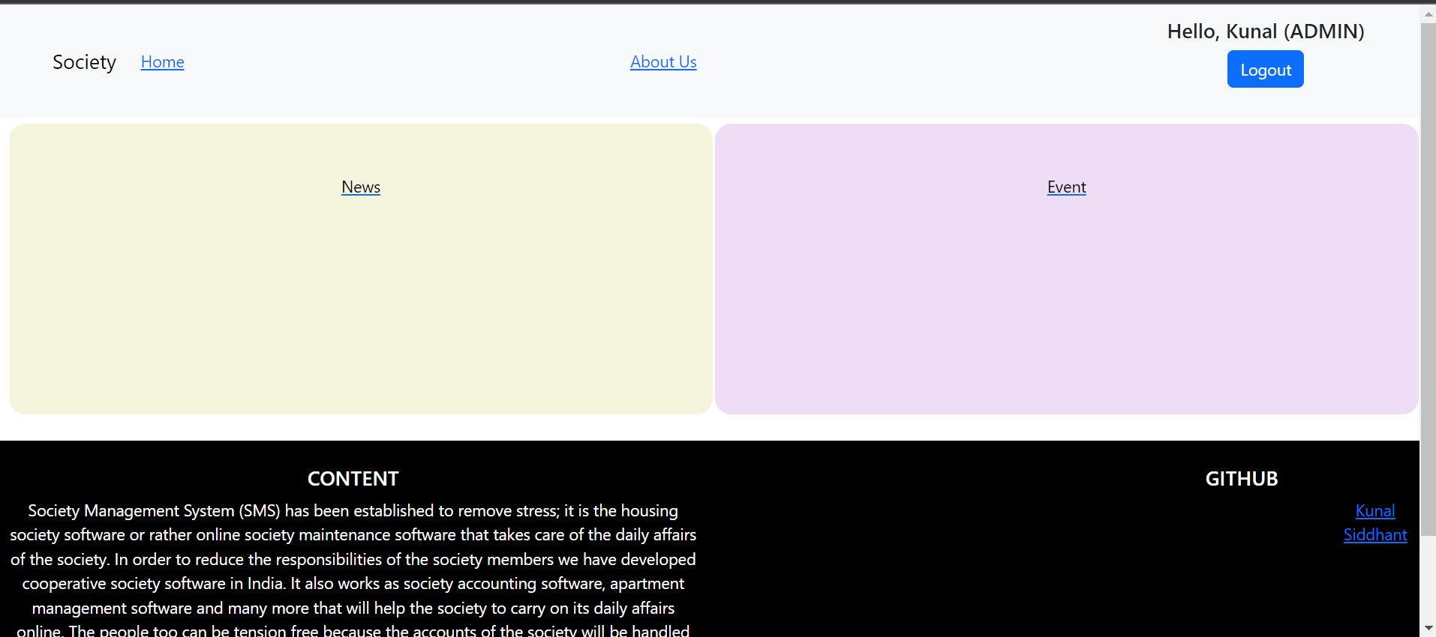
News and Event page in Admin :

Slide 26
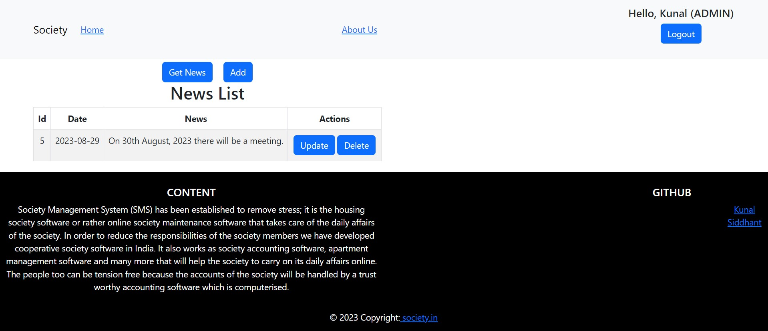
News page in Admin :

Slide 27
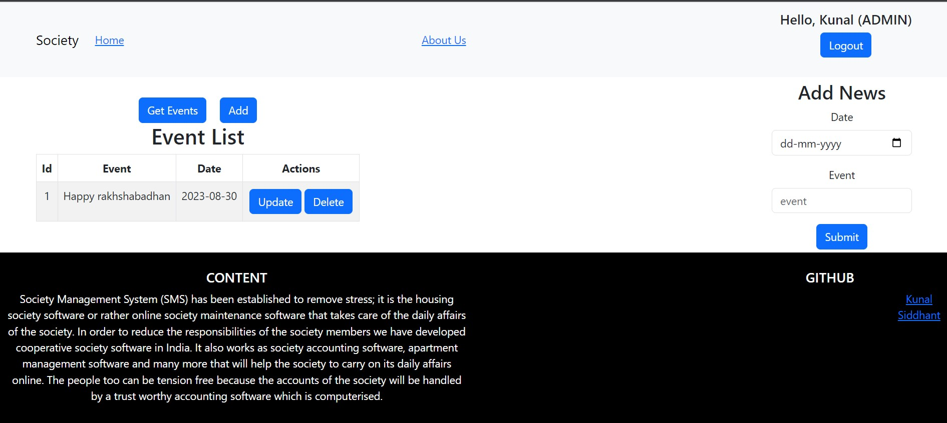
Event page in Admin :

Slide 28
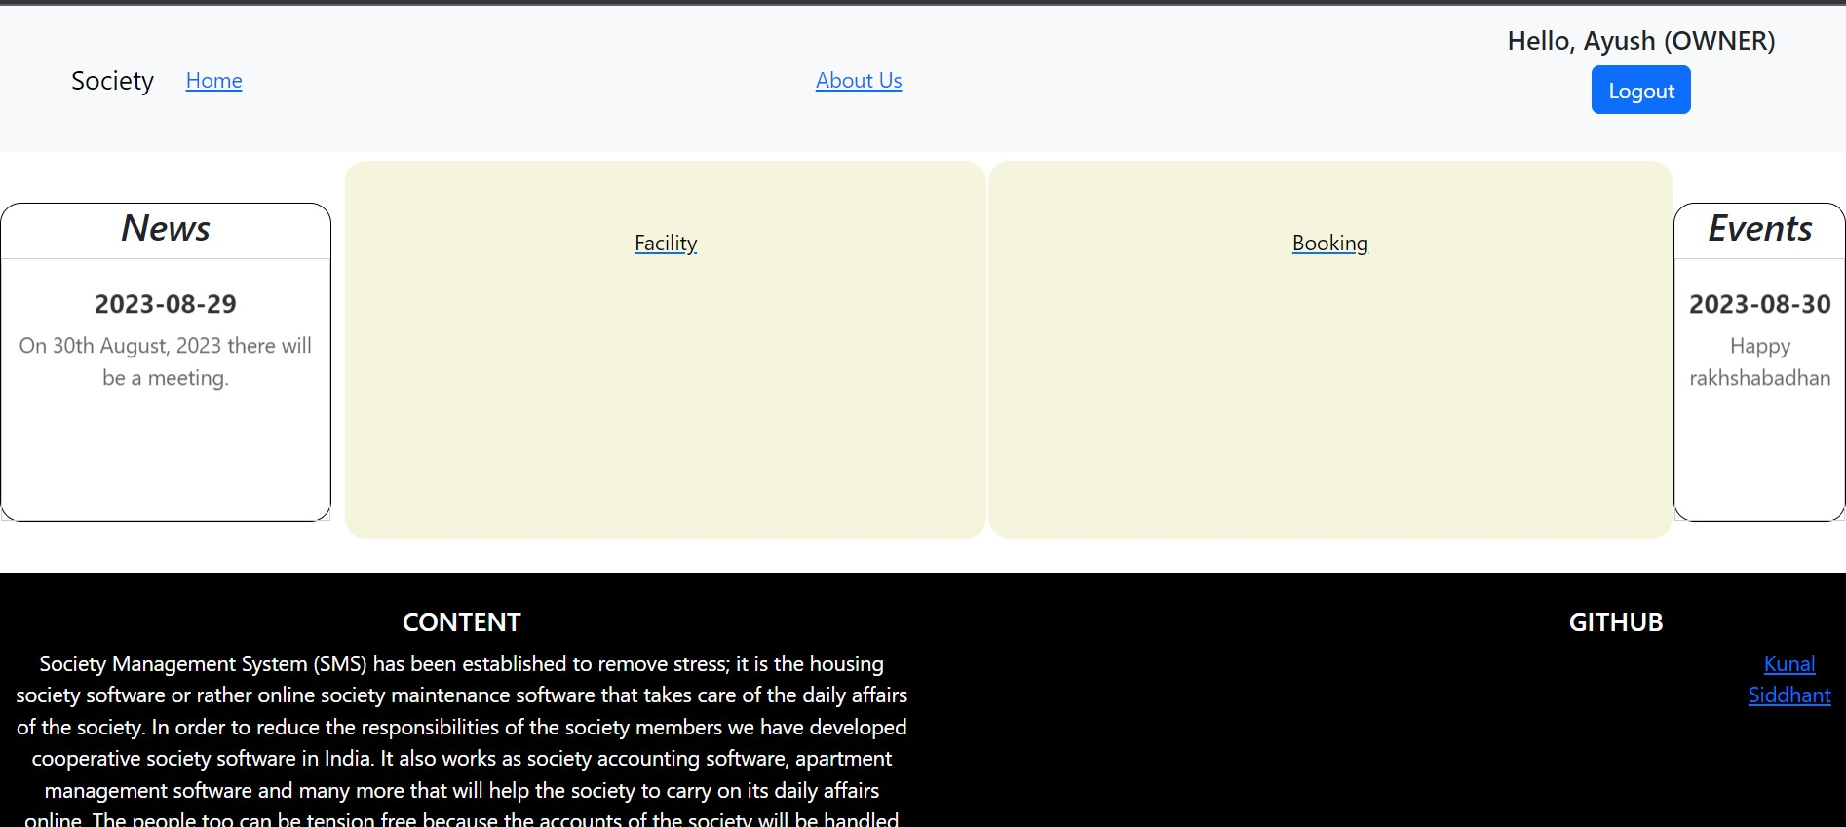
House owner Home page :

Slide 29
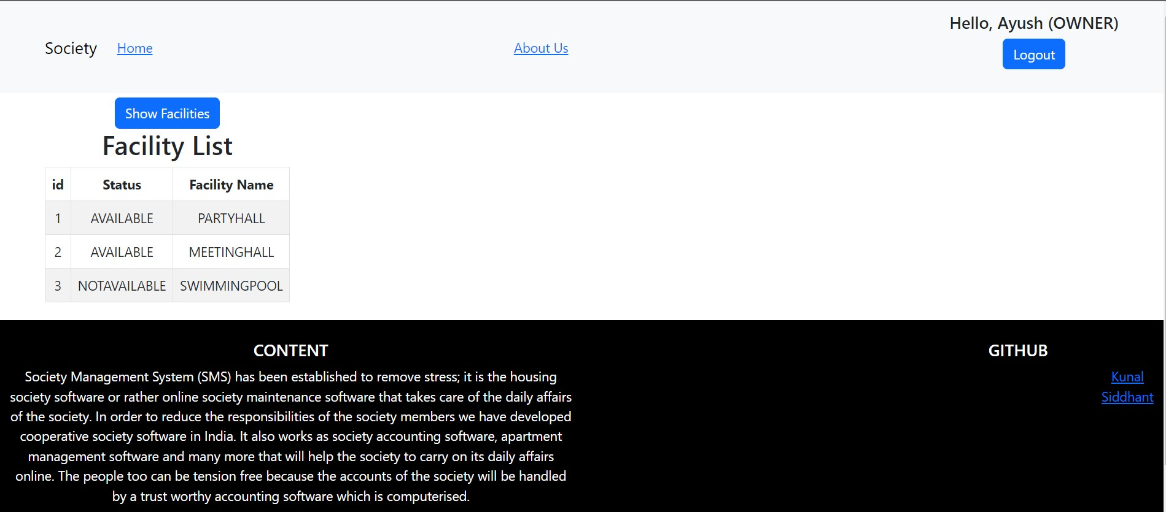
House owner Facility page :

Slide 30
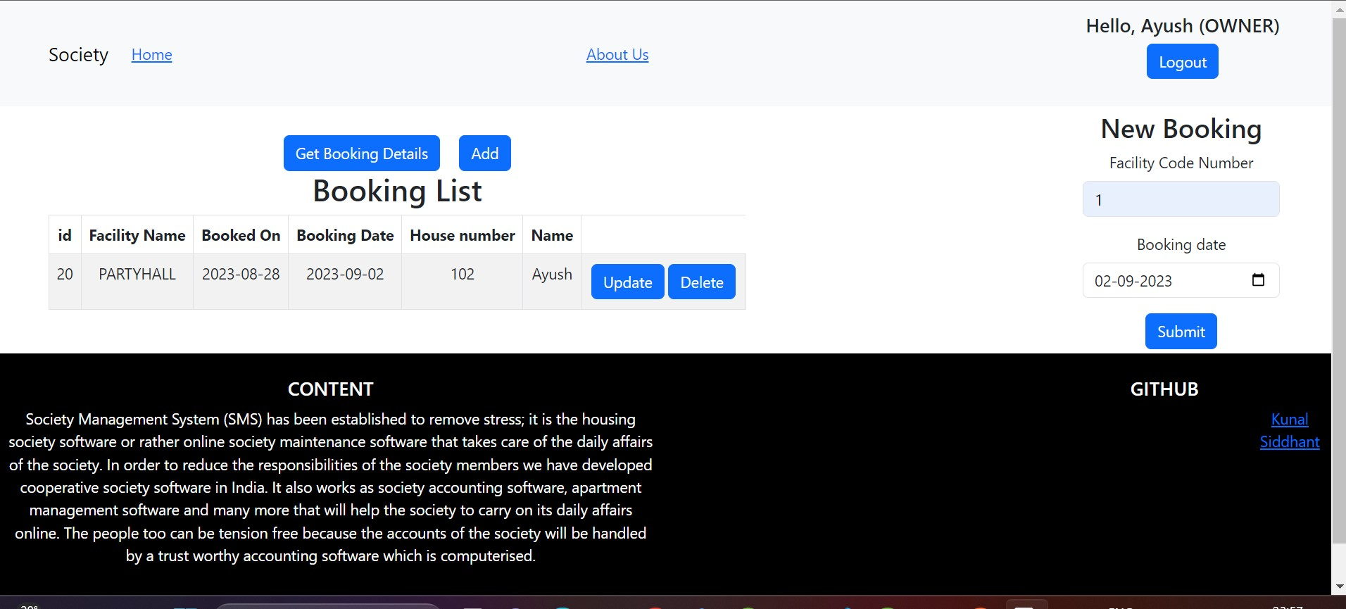
House owner Booking page :

Slide 31
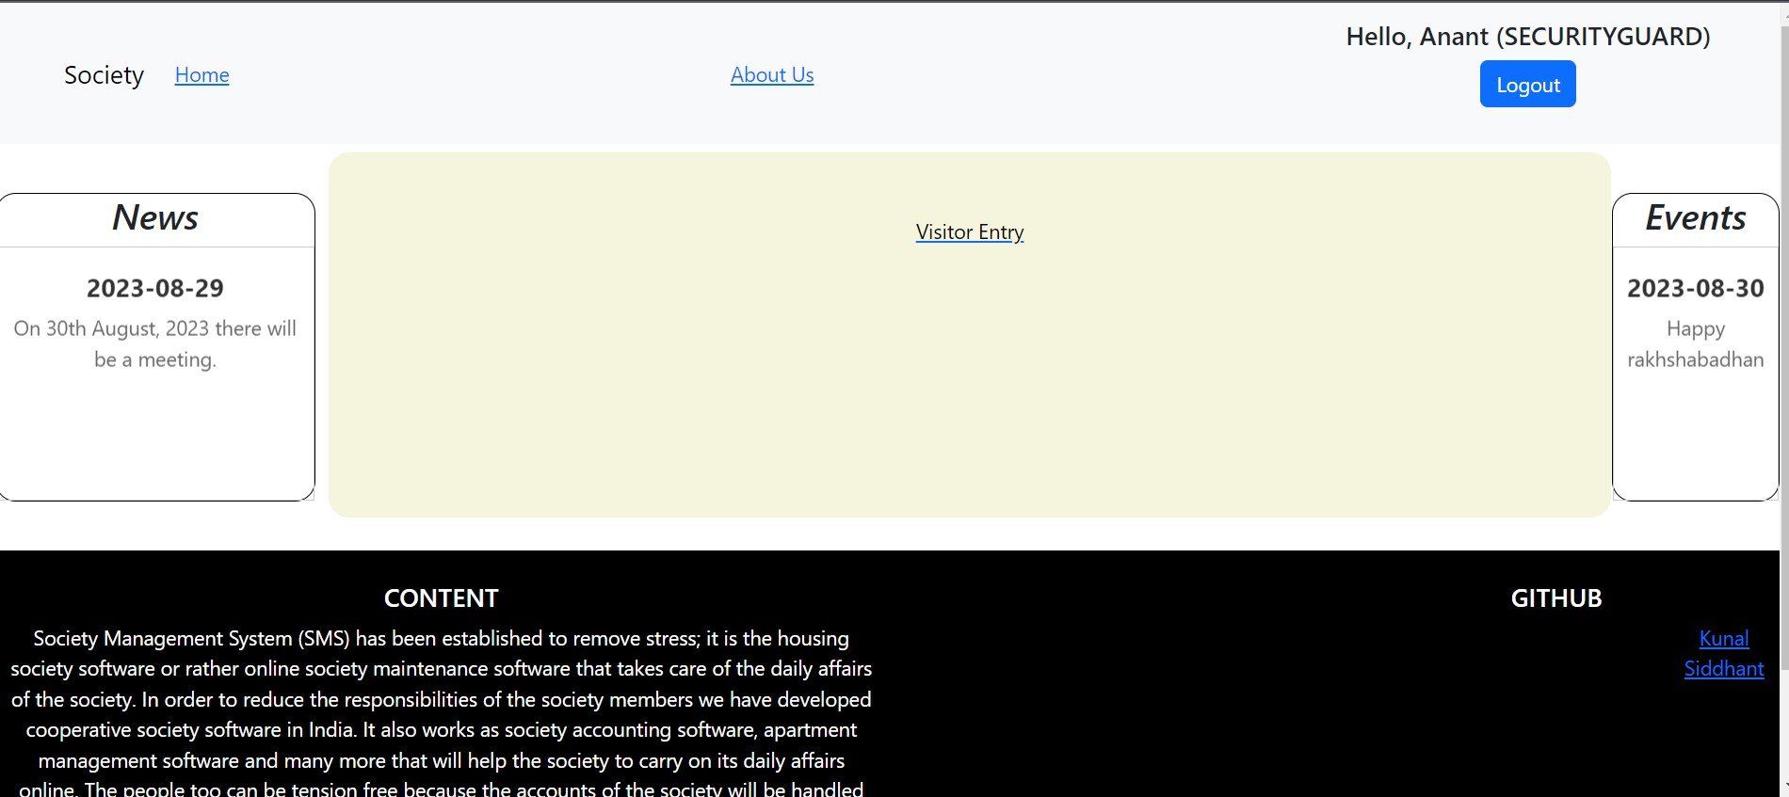
Security guard Home page :

Slide 32
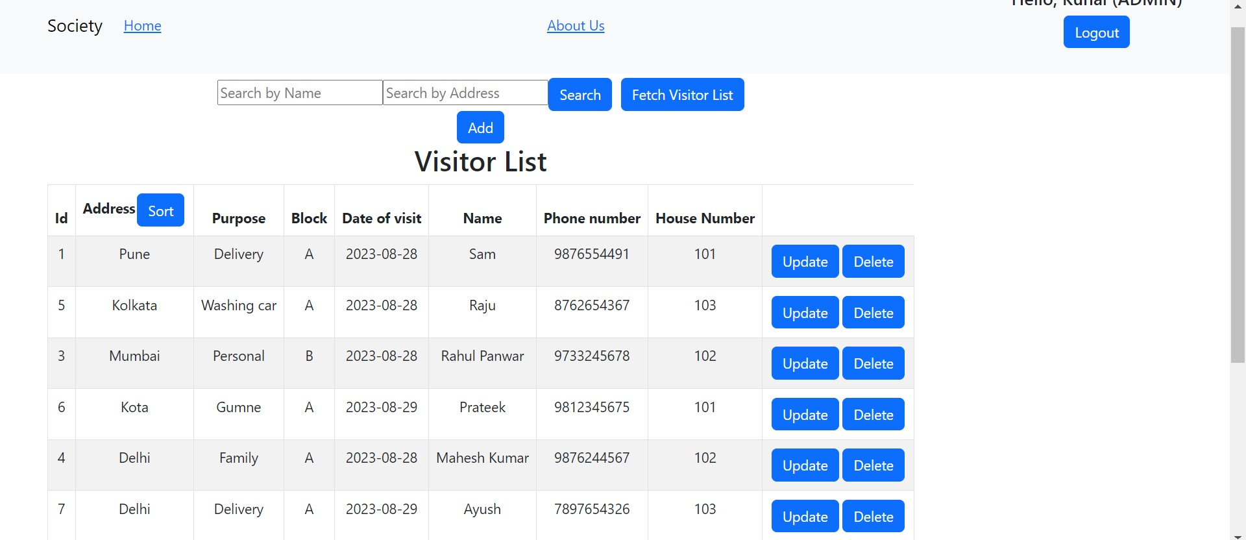
Security guard Visitor page :

Slide 33
Thank You

